Slide 1
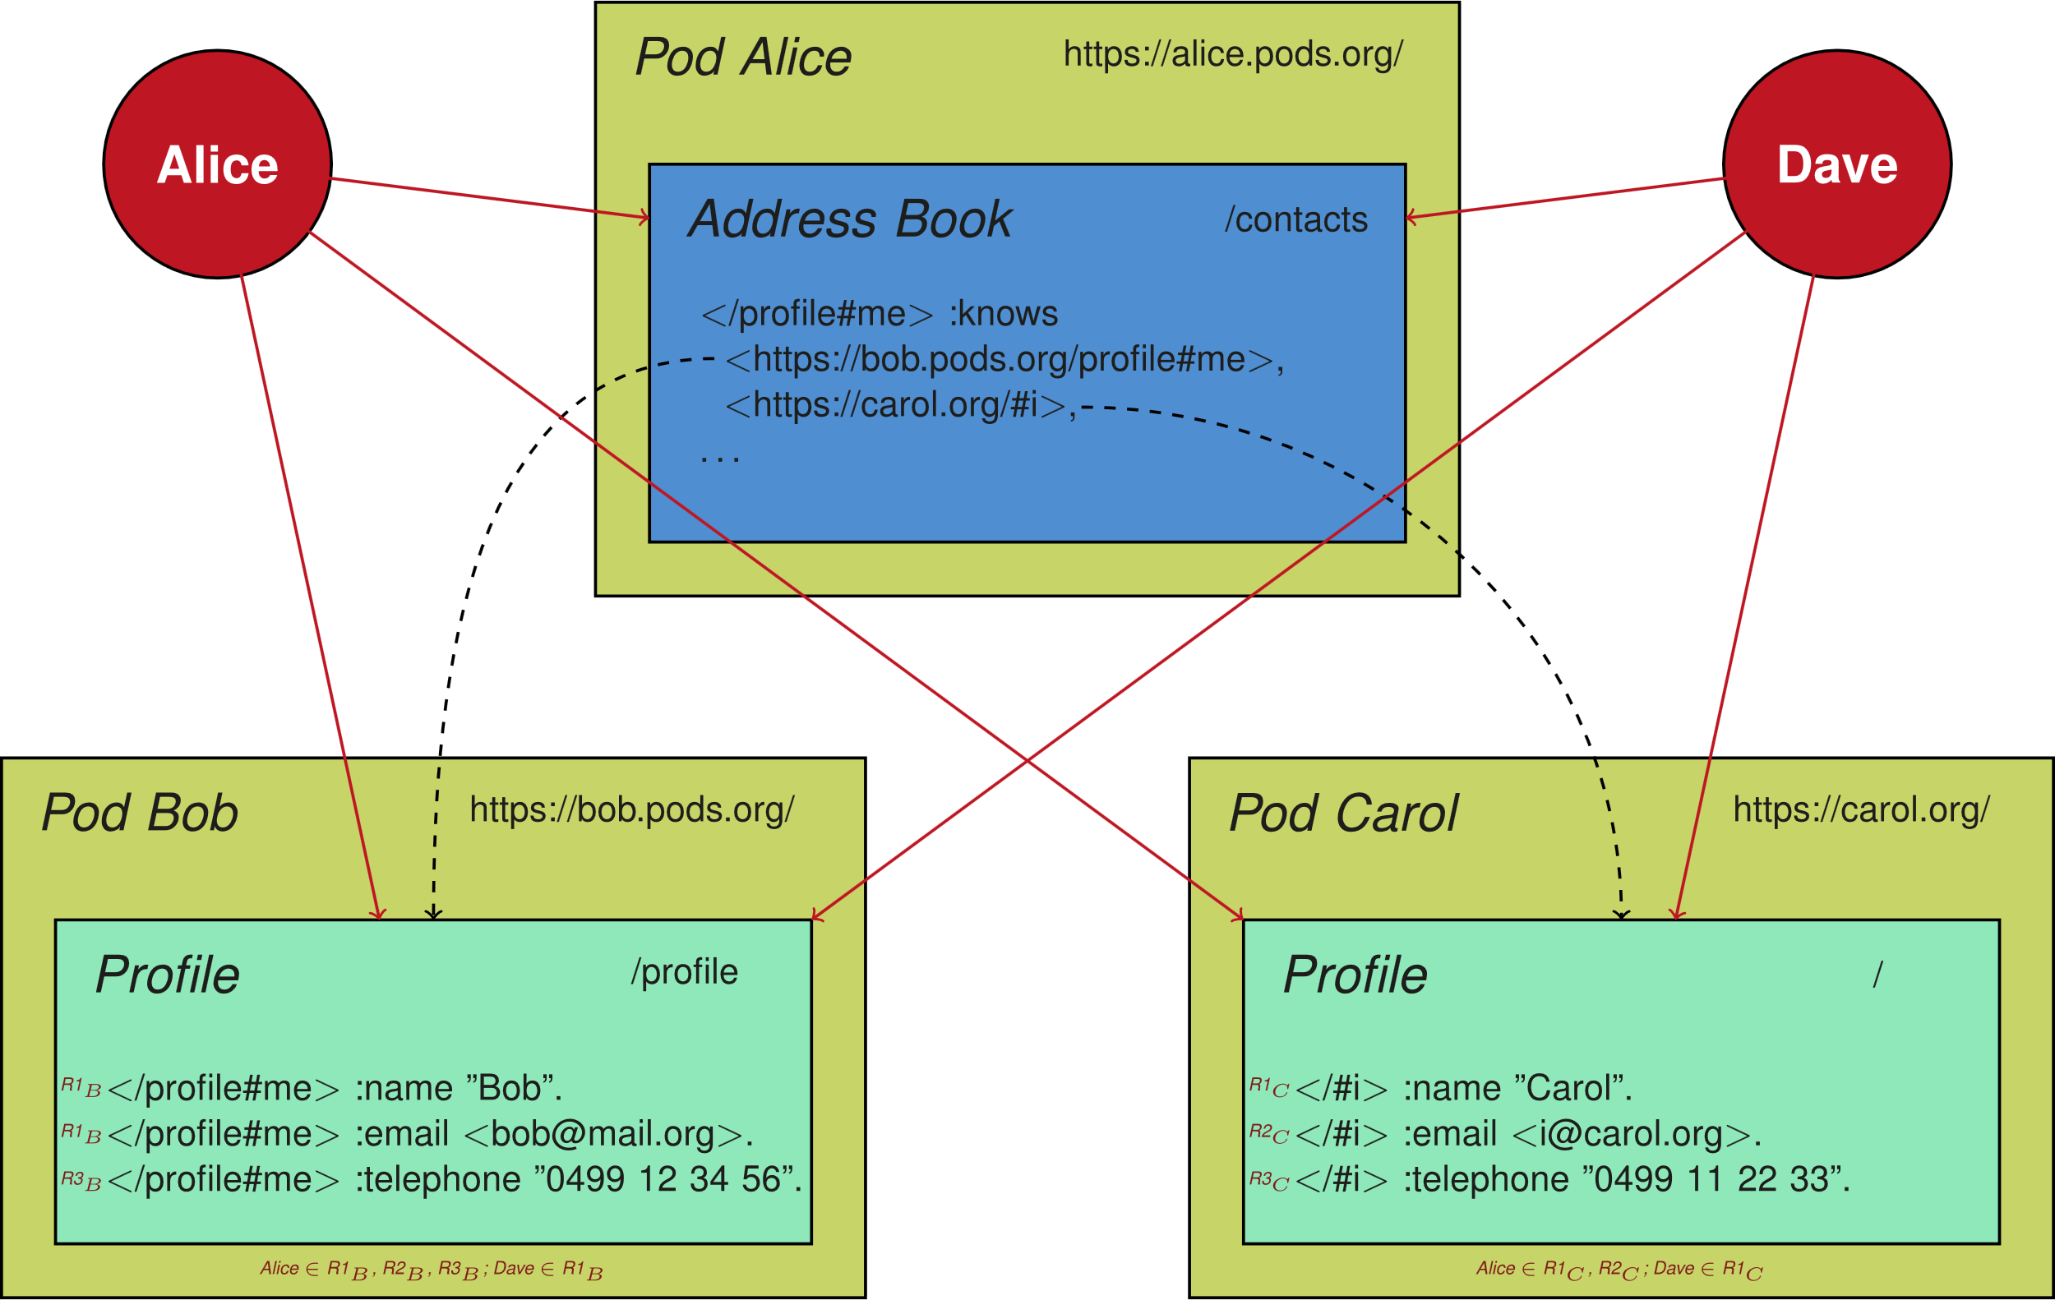
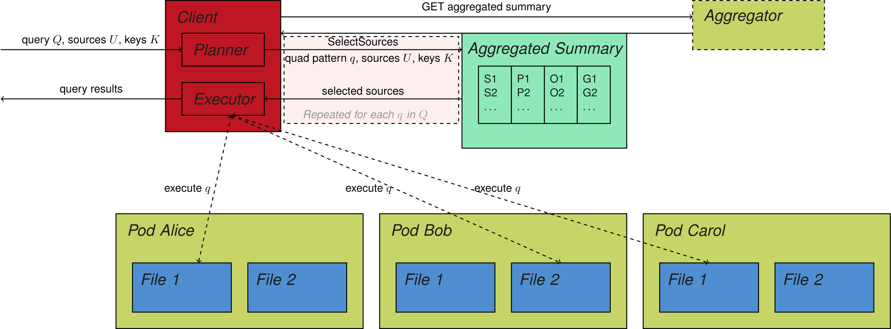
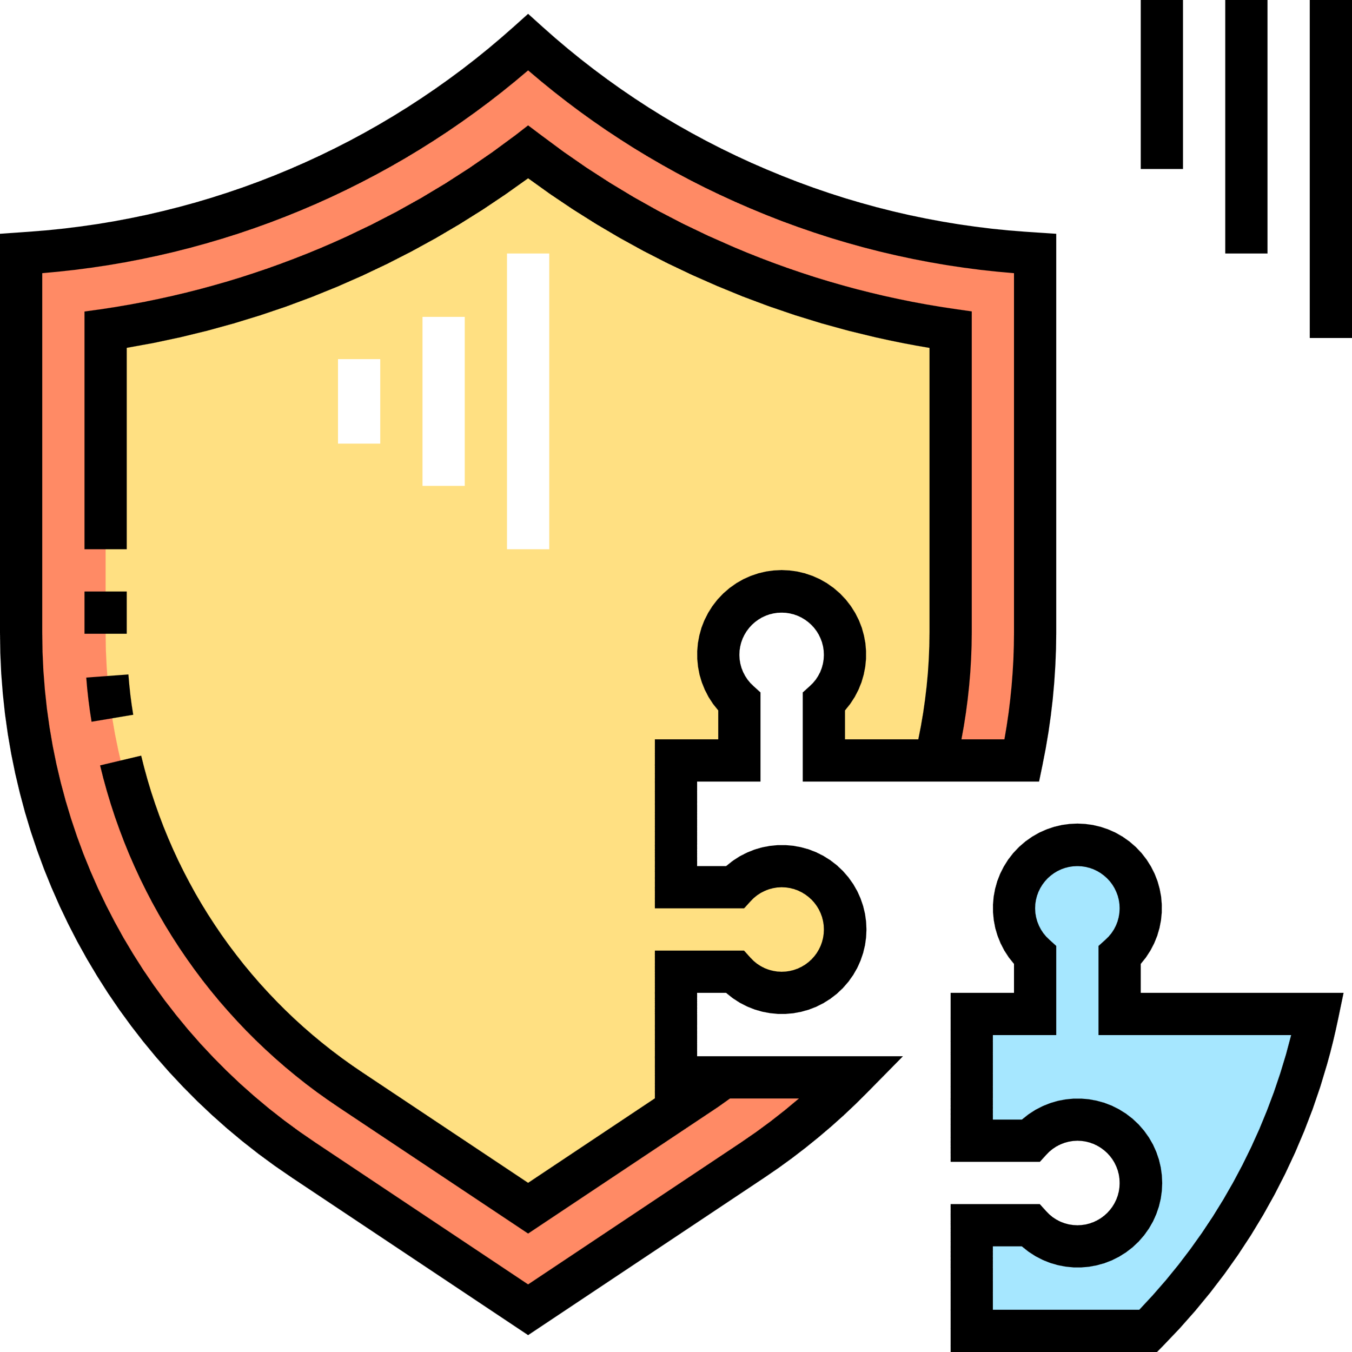



Make querying safe again!
Privacy-preserving querying over decentralized environments
In decentralized environments such as Solid not all data is necessarily public
Query engines need to be able to authenticate themselves to sources
Privacy-preserving aggregation techniques need to be introduced, so that untrusted third-parties are not able to read data
Alice wants to call everyone she knows
Dave wants to send an email to everyone Alice knows
Alice wants to send an email to everyone she knows
Dave wants to call everyone Alice knows
Overview of the personalized address book use case where Alice, Bob and Carol have a data pod, and Alice and Dave aim to read certain data. Alice has an address book that contains links to the profiles of Bob and Carol. All triples in each profile are annotated with a role for users that can read that triple. Full lines indicate data reading by people, and dashed lines indicate data links.
Privacy-Preserving Querying
Fine-grained Access control
Decentralized Identity Management
Ruben Taelman
Sabrina Kirrane
Simon Steyskal
Icons made by Pixelmeetup from www.flaticon.com

Slide 2
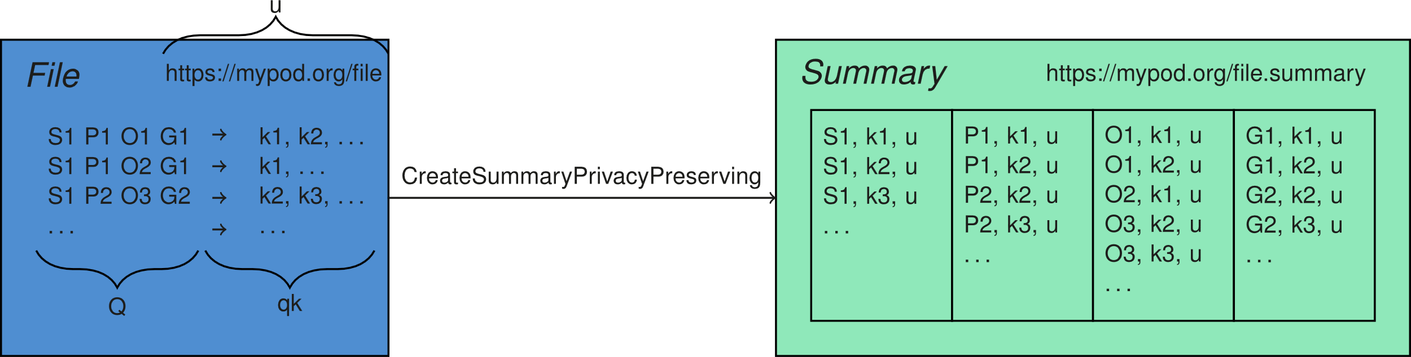
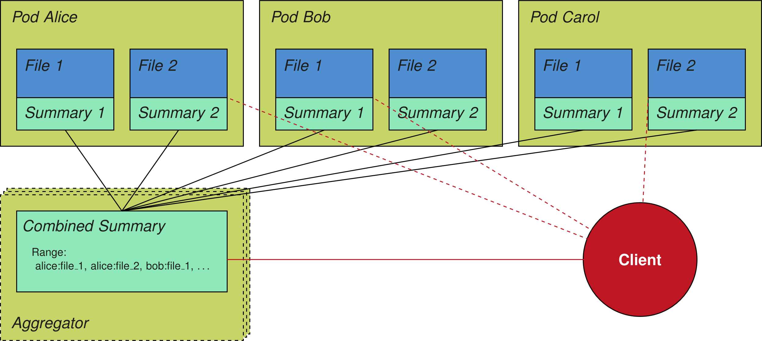
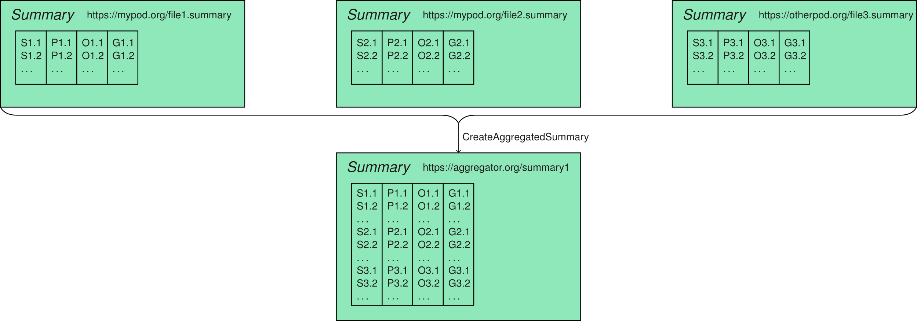
Accessing data the right way!
Privacy-preserving querying over decentralized environments
In decentralized environments such as Solid not all data is necessarily public
Query engines need to be able to authenticate themselves to sources
Privacy-preserving aggregation techniques need to be introduced, so that untrusted third-parties are not able to read data
Privacy-Preserving Aggregation
Fine-grained Access control
<http://alice.pod/share/policy> a odrl:Policy ;
odrl:permission [
odrl:target <http://alice.pod/share/photoAnnotations/> ;
odrl:action [
rdf:value acl:Read ;
odrl:refinement [# refine the agent
a sh:NodeShape ;
sh:targetObjectsOf ldp:contains ;
sh:rule [ a sh:SPARQLRule ;
sh:construct """ CONSTRUCT WHERE { $this a ?o . } """ ;
sh:condition [
sh:pattern "private" ; sh:flags "i" ;
sh:property [
sh:path [ sh:inversePath ldp:contains ] ;
sh:hasValue <http://alice.pod/share/photoAnnotations/> ;
sh:minCount 1 . ]]]]]].
<http://alice.pod/share/policy> a odrl:Policy ;
odrl:permission [
odrl:target [
a odrl:AssetCollection ;
odrl:source <https://alice.databox.me/docs/file1> ;
odrl:refinement [ # refine the asset/resource
a sh:NodeShape ;
sh:pattern "public" ; sh:flags "i"
] ] ;
odrl:action acl:Read ; ] .
<http://alice.pod/share/policy> a odrl:Policy ;
odrl:permission [
odrl:target <http://alice.pod/share/photoAnnotations/> ;
odrl:action acl:Read ;
odrl:assignee [
a foaf:Agent ;
odrl:source <https://alice.example.com/work-groups#Accounting>;
odrl:refinement [ # refine the agent
a sh:NodeShape ;
sh:property [
sh:path foaf:interest ; sh:minCount 1 ;
sh:hasValue <#photography> ]]]] .
Shape the resource that can be accessed
Shape the agents/party the policy applies to
Shape the action/mode that can be performed on the data
Privacy-Preserving Federated Querying
Ruben Taelman
Sabrina Kirrane
Simon Steyskal
Icons made by Pixelmeetup from www.flaticon.com

Slide 3
@prefix acl: <http://www.w3.org/ns/auth/acl#> . @prefix odrl: <http://www.w3.org/ns/odrl/2/> . @prefix rdf: <http://www.w3.org/1999/02/22-rdf-syntax-ns#> . @prefix rdfs: <http://www.w3.org/2000/01/rdf-schema#> . @prefix sh: <http://www.w3.org/ns/shacl#> .
<http://alice.pod/share/policy> a odrl:Policy ;
odrl:conflict odrl:perm ;
odrl:prohibition [
odrl:target <http://alice.pod/share/photoAnnotations/> ;
odrl:action odrl:use
] ;
odrl:permission [
odrl:target [
a odrl:AssetCollection ;
odrl:source <https://alice.databox.me/docs/file1> ;
odrl:refinement [ # refine the asset/resource
a sh:NodeShape ;
sh:pattern "public" ;
sh:flags "i"
]
] ;
odrl:action acl:Read ;
] ;
odrl:permission [
odrl:target <http://alice.pod/share/photoAnnotations/> ;
odrl:action [
rdf:value acl:Read ;
odrl:refinement <#AccessRulesShape> # refine the action
]
] ;
odrl:permission [
odrl:target <http://alice.pod/share/photoAnnotations/> ;
odrl:action acl:Read ;
odrl:assignee [
a foaf:Agent ;
odrl:source <https://alice.example.com/work-groups#Accounting>;
odrl:refinement [ # refine the agent
a sh:NodeShape ;
sh:property [
sh:path foaf:interest ;
sh:minCount 1 ;
sh:hasValue <#photography>
]
]
]
] .

